Slide 1




INFOSYS SPRINGBOARD · VIRTUAL INTERNSHIP 7.0
Cyber Threat Analytics
Platform & Incident
Visualization System
An end-to-end Power BI business-intelligence solution that turns 40,000 raw cybersecurity events into clear, actionable threat intelligence.
SECURITY INTELLIGENCE FRAMEWORK
PRESENTED BY Ponnuru Nithin Mentor · Ms. Nithyasri S J
40,000 Incidents
7 Dashboards
28 States

Slide 2




01
01 · PROJECT OBJECTIVES
What the framework set out to achieve
01
02
Consolidate & Model Data
Detect & Quantify Threats
Unify 40,000 raw cybersecurity incident records into a single, coherent Power BI analytical framework.
Identify attack patterns, severity levels and anomaly behaviour across attack types, protocols and geography.
03
04
Monitor Behaviour & Response
Communicate Intelligence
Track network traffic, user/device behaviour and how effectively incidents are blocked, logged or ignored.
Convert complex log data into clear KPIs and visuals for both technical analysts and non-technical audiences.

Slide 3




02
02 · PROJECT DESCRIPTION
Seven interconnected dashboards
The Advanced Threat Incident Analytics & Security Visualization Framework is built entirely in Microsoft Power BI on a 40,000-record Kaggle dataset spanning Jan 2020–Oct 2023 across 28 Indian states. It transforms raw log data into seven themed, drill-able dashboards that give a 360° view of the threat landscape.
MODULE 1
MODULE 2
MODULE 3
Cyber Security Attacks Analysis
Threat Detection & Anomaly
Network Traffic Analysis
KPI overview of attack volume, type, action and geographic spread.
Anomaly-score bands, gauge and interactive slicer-driven investigation.
Protocol, packet-type and severity behaviour across the network.
MODULE 4
MODULE 5
MODULE 6
User Behaviour Analytics
Threat Profile & Severity
Alert Monitoring & Response
OS/browser mix, user & device metrics and top high-anomaly source IPs.
Decomposition tree, signatures and severity mix by network segment.
Alert / IDS coverage, block-rate trends and response effectiveness.

Slide 4







03
03 · TOP VISUALIZATIONS / COMPONENTS USED
The visual toolkit behind the framework
VISUAL TYPE
PURPOSE / WHAT IT SHOWS
KPI Cards & Gauges
Headline metrics - Total Attacks (40K), High Severity, Block Rate % and Malware Detected.
Donut & Pie Charts
Composition of attack types, action taken and anomaly-score bands at a glance.
Decomposition Tree
Interactive drill from total attacks → attack type → severity level.
Geographic Map
Attack volume and type plotted across 28 Indian states and cities.
Ribbon & Waterfall
Rank shifts of attack types over time and block-rate contribution by class.
Sankey Diagram
Flow of every attack type into its Blocked / Ignored / Logged outcome.
Gauge & Key Influencers
Average anomaly score and the factors that drive a 'Blocked' outcome.

Slide 5
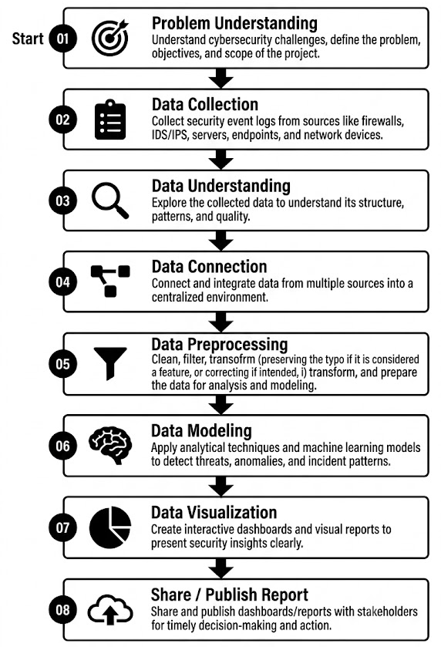
04
04 · PROJECT WORKFLOW
The eight-stage Power BI pipeline

Slide 6
05
05 · PROJECT EXECUTION MILESTONES
Four structured milestones
The project was executed through 4 structured milestones to ensure systematic progress and accuracy.
DATASET / SOURCE Kaggle — “Cyber Security Attacks” · 40,000 records · Jan 2020 – Oct 2023 · 28 Indian states · 25 features
M1
M2
M3
M4
Data Foundation & Understanding
Core Dashboards & Behaviour
Advanced Threat Profiling
Alert Monitoring & Response
Dataset acquisition, cleaning through 19 Power Query steps, data modeling and base KPIs.
Attack, network-traffic, anomaly and user-behaviour dashboards with KPI cards.
Decomposition tree, severity profiling, insight synthesis and documentation.
Security alert monitoring plus the attack-trends & response-effectiveness dashboards.

Slide 7



06
06 · CHALLENGES FACED & RESOLUTIONS
Obstacles met and how they were solved
CHALLENGES FACED
RESOLUTIONS
1
Keeping a 40,000-row model responsive while every visual stayed interactive.
Wrote efficient DAX and disabled unnecessary auto date/time tables to keep the model fast.
2
Designing accurate derived metrics (% High Severity, Block Rate %, Anomaly Score Bands) that stayed correct under every filter.
Iteratively tested and validated each measure across all slicer interactions and filter contexts.
3
Interpreting a near-uniform dataset and keeping one visual language across seven dashboards built by different members.
Cross-validated figures across visuals and standardised colours & severity encoding, coordinating via Teams and GitHub.

Slide 8


07
07 · LEARNINGS & SKILLS ACQUIRED
What this internship built
TECHNICAL SKILLS
SOFT SKILLS
End-to-end Power BI - Power Query ETL, modeling & publishing
DAX measures & calculated columns (CALCULATE, DIVIDE, COUNTROWS, banding)
Advanced visuals - decomposition tree, ribbon, treemap, gauge, Sankey
Date tables, relationships & version control with GitHub
Communicating analytical findings clearly to non-technical audiences
Team collaboration, ownership & accountability via Microsoft Teams
Time management and delivery against milestone deadlines
OVERALL EXPERIENCE Hands-on mastery of Power BI, DAX and analytical storytelling — reinforcing the real-world value of data-driven, evidence-based decision-making.

Slide 9

08
08 · FUTURE ENHANCEMENTS & KEY INSIGHTS
Where the framework goes next
KEY INSIGHTS
FUTURE ENHANCEMENTS
33.6%
DDoS marginally leads a broad, multi-vector threat mix (Malware 33.3%, Intrusion 33.2%).
Integrate near-real-time data via scheduled refresh or DirectQuery
Add predictive analytics - anomaly forecasting & risk scoring (Python / R / Azure ML)
Row-level security for role-based dashboards + automated alerting via Power Automate
Drill-through to raw incidents, a true India choropleth, and publish to the Power BI Service
~45%
Windows is the most-targeted OS; malware indicators appear in exactly 50% of events.
33.8%
Only about a third of attacks are actively blocked — a clear, quantified response gap.

Slide 10


09
09 · CONCLUSION
From raw events to intelligence
The Cyber Threat Analytics Platform successfully transformed 40,000 raw cybersecurity incidents into seven interactive Power BI dashboards — delivering a complete, drill-able view of the threat landscape for technical and non-technical audiences alike.
Technical Impact
Practical Experience
Overall Outcome
Hands-on mastery of Power BI, DAX, data modeling and analytical storytelling across a full BI pipeline.
Real-world business intelligence applied to security monitoring, reporting and executive decision-making.
Quantified a clear opportunity to strengthen response (only ~1/3 blocked) and a strong base for future work.

Slide 11


10
10 · ACKNOWLEDGEMENTS & REFERENCES
With gratitude
ACKNOWLEDGEMENTS
REFERENCES
I would like to express my heartfelt gratitude to:
Kaggle - “Cyber Security Attacks” dataset (40,000 records, 2020 -2023)
Microsoft Power BI & DAX official documentation and community resources
Infosys Springboard learning modules and milestone framework
Infosys Springboard Team - for a structured, industry-aligned internship platform
Ms. Nithyasri S J (Mentor) - for consistent guidance, feedback and encouragement
Team members - Priyam Sinha & Ponnuru Nithiin, for strong collaboration
Power BI community - documentation and resources used during development

Slide 12
Thank You
Cyber Threat Analytics Platform with Incident Visualization System
Siddhant Singh · Infosys Springboard Virtual Internship 7.0 · Mentor: Ms. Nithyasri S J

